Slide 1
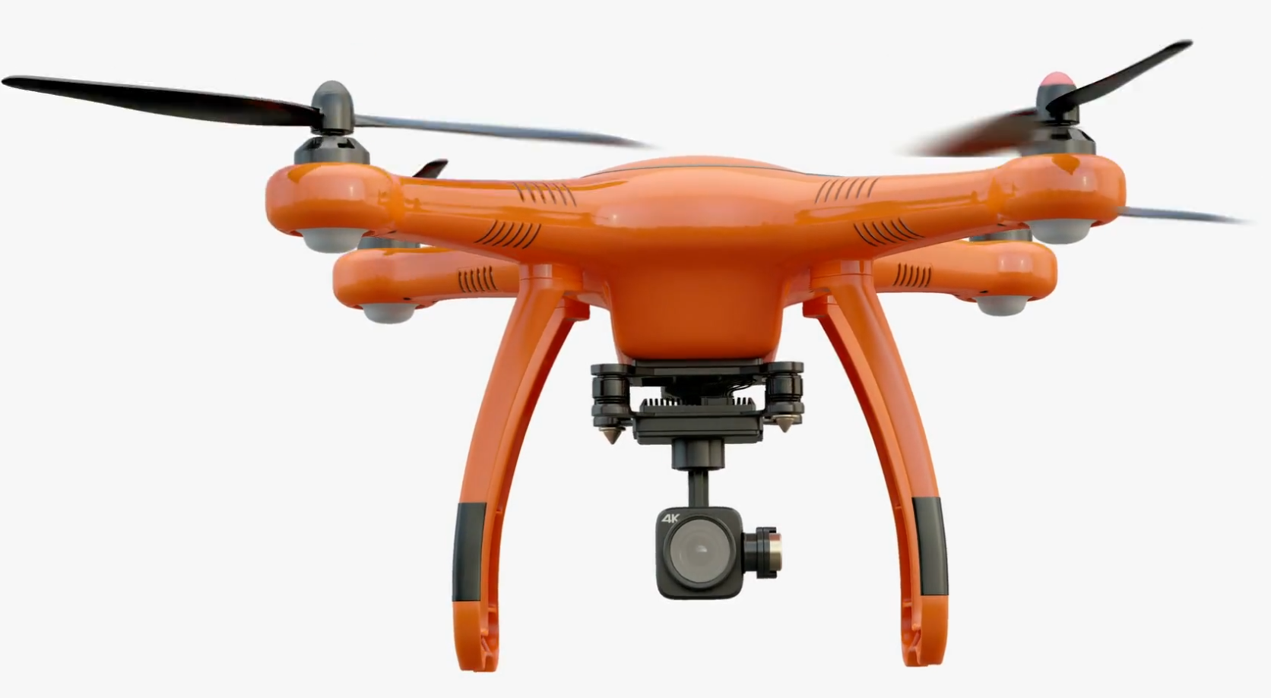
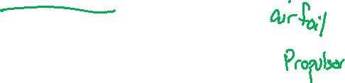
Rotating machinery
Propellers
Tyler Dare

Slide 2
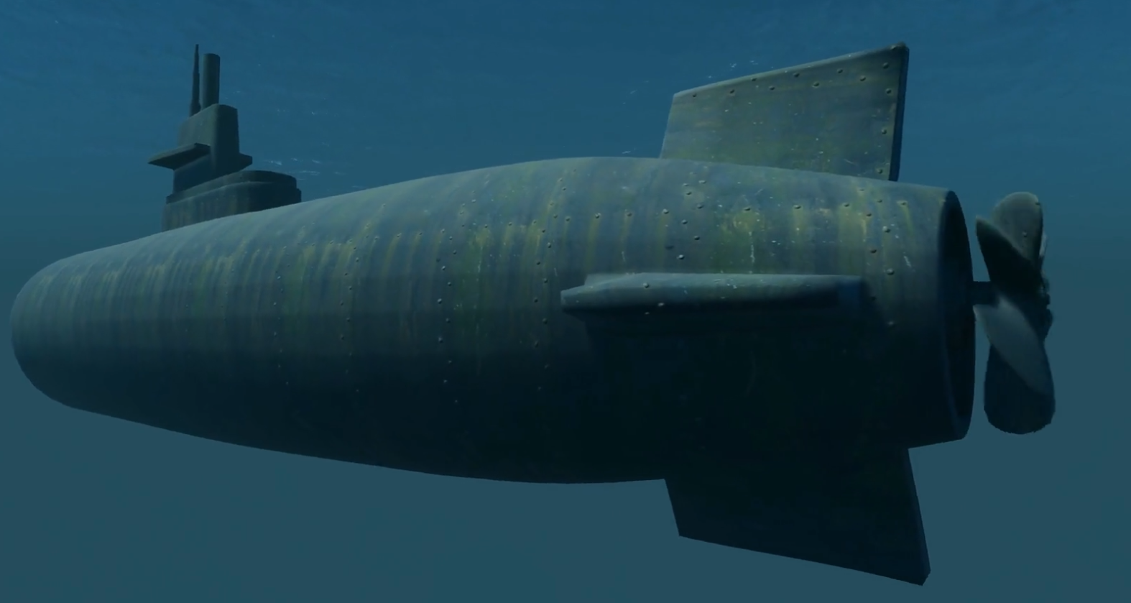
How to make a quiet submarine
Dominant Vibrating and Radiating Structures
Vehicle Shell
Low Frequency
Propulsor
Mid Frequency
SPL, dB
Rotor Spatial Inflow Distortions Generating Rotor Unsteady Lift
Rotating Blades
High Frequency
Rotor Inflow Turbulence Interacting with Rotor LE
Dominant Sources of Rotor Excitation
(curves represent direct radiation – proportional to force)
Cavitation
Blade Boundary Layer Turbulence Interacting with Rotor Blade TE
Log (Frequency)

Slide 3
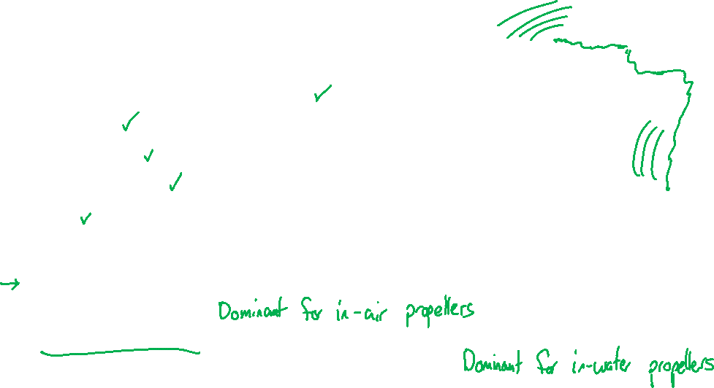
Propeller noise
Rotor noise is a dominant mechanism in many systems:
Boats, ships, and submarines
Airplanes
Helicopters
Wind turbines
Fans
Noise from rotors takes one two paths:
“Direct noise”: unsteady flow causes acoustic fluctuations
“Re-radiated noise”: unsteady flow causes vibrations, then vibrating structure radiates sound

Slide 4
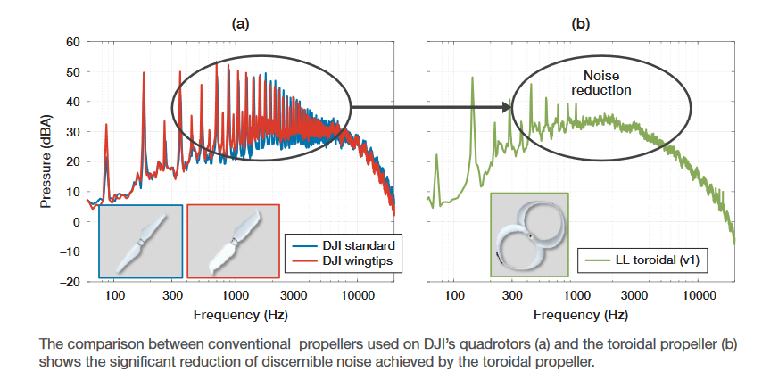
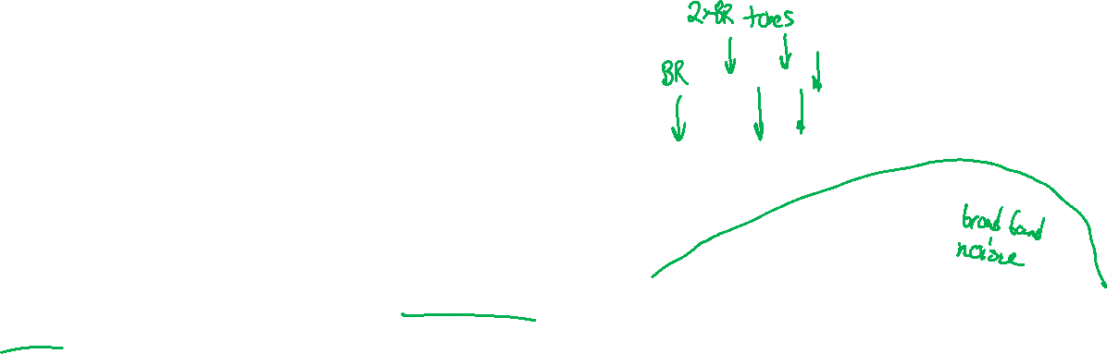
Propeller noise sources
Noise from propellers has tonal and broadband features.
Broadband noise is caused by turbulence
Ingested turbulence
Self-generated turbulence
Tonal noise (also just called “blade rate noise”) is caused by blades interacting with large flow structures
Ingested wakes
Self-generated vortices

Slide 5
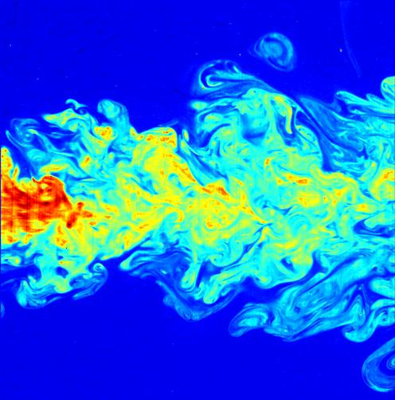
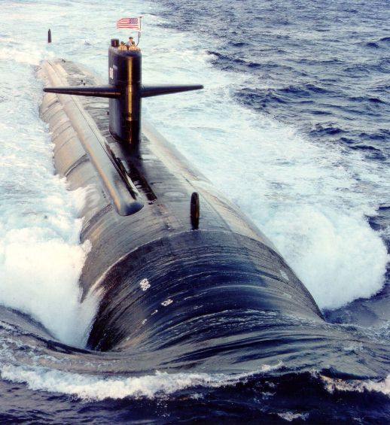
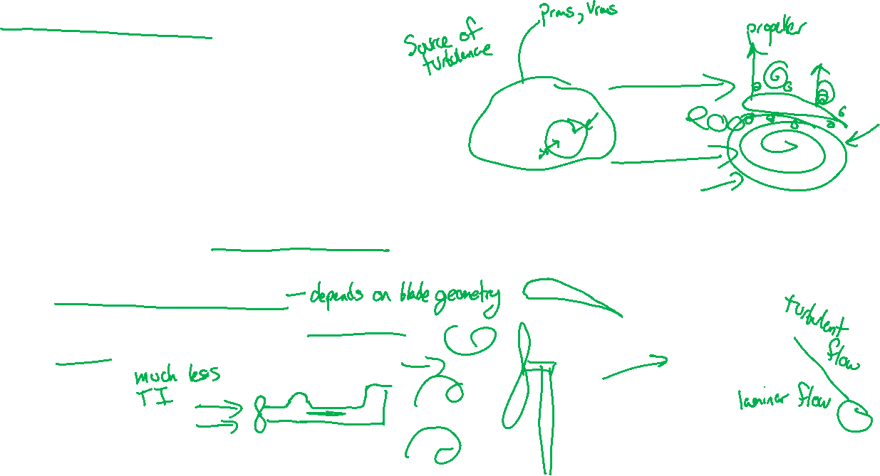
Turbulence ingestion noise
A source of turbulence is somewhere upstream of the rotor
The turbulence causes unsteady forces to be applied to the propeller. The excitation depends on:
Amplitude of the fluctuating velocities
How the blade responds to fluctuating velocity (“gust response”)
How large the vortices are (“correlation length”)
By C. Fukushima and J. Westerweel, Technical University of Delft, The Netherlands - Own work, CC BY 3.0, https://commons.wikimedia.org/w/index.php?curid=3082535

Slide 6
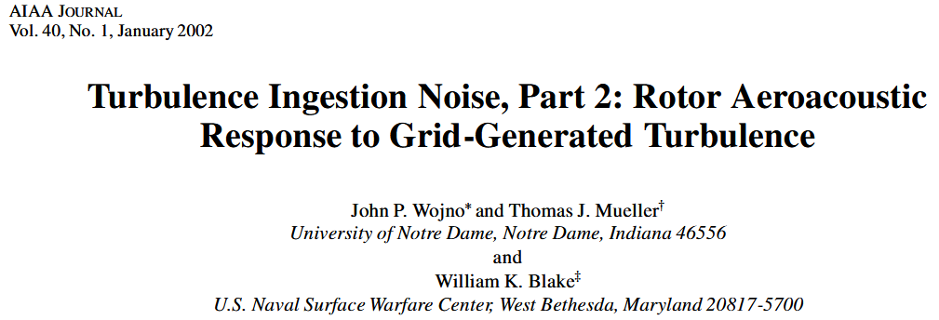
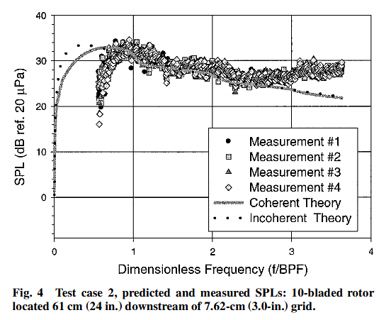
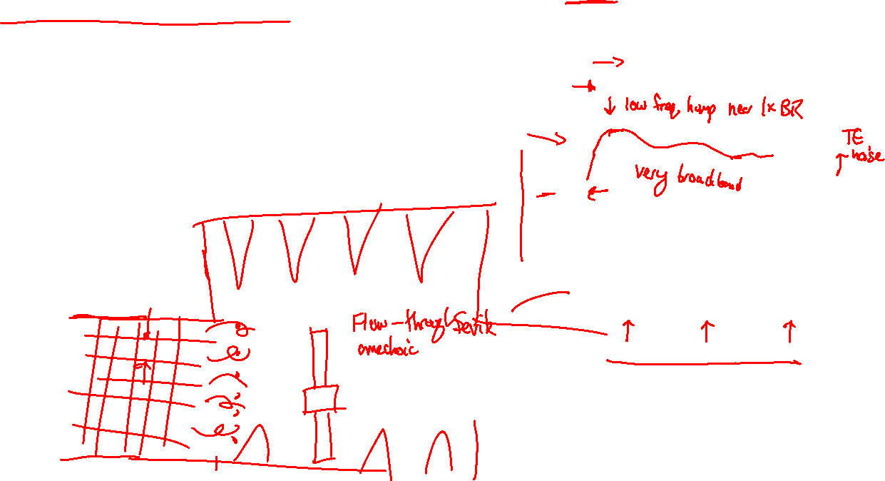
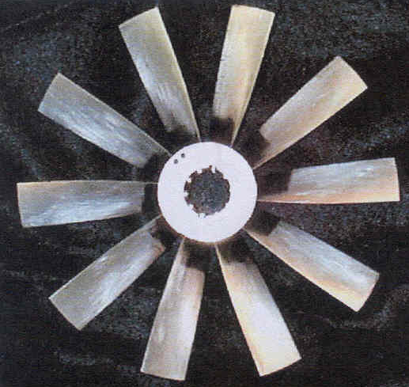
Turbulence ingestion noise
TI noise has been measured in wind and water tunnels.
TI noise tends to be the dominant source of broadband noise below a few times the blade passage frequency.
The turbulence parameters can be hard to quantify and predict.
It is still the subject of research.

Slide 7
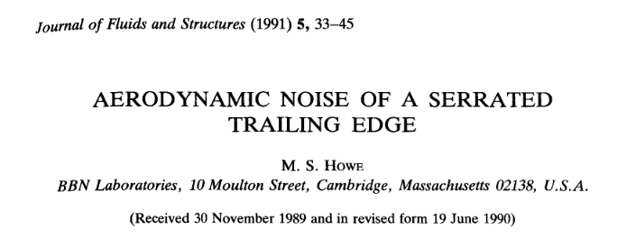
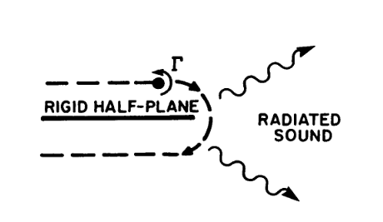
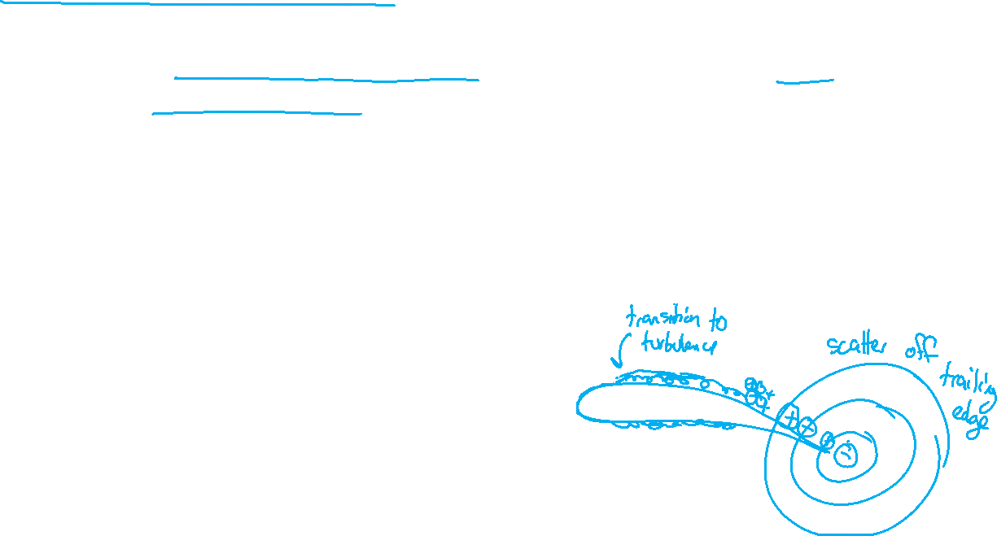
Self-generated turbulence noise
Also called “boundary layer turbulence noise” or “trailing edge noise”
Turbulence forms over the rotor itself.
When turbulence reaches the trailing edge, the eddies are suddenly able to expand or contract, causing noise.
Excitation depends on turbulence parameters and blade geometry.
TE noise tends to be the dominant source at higher frequencies.

Slide 8
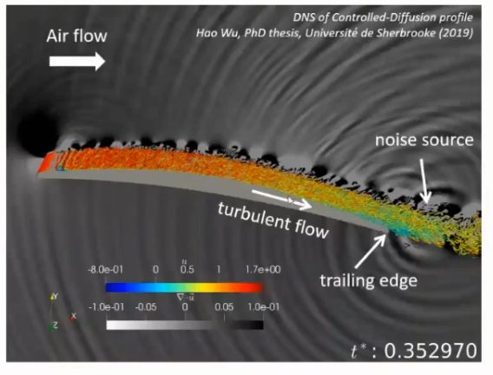
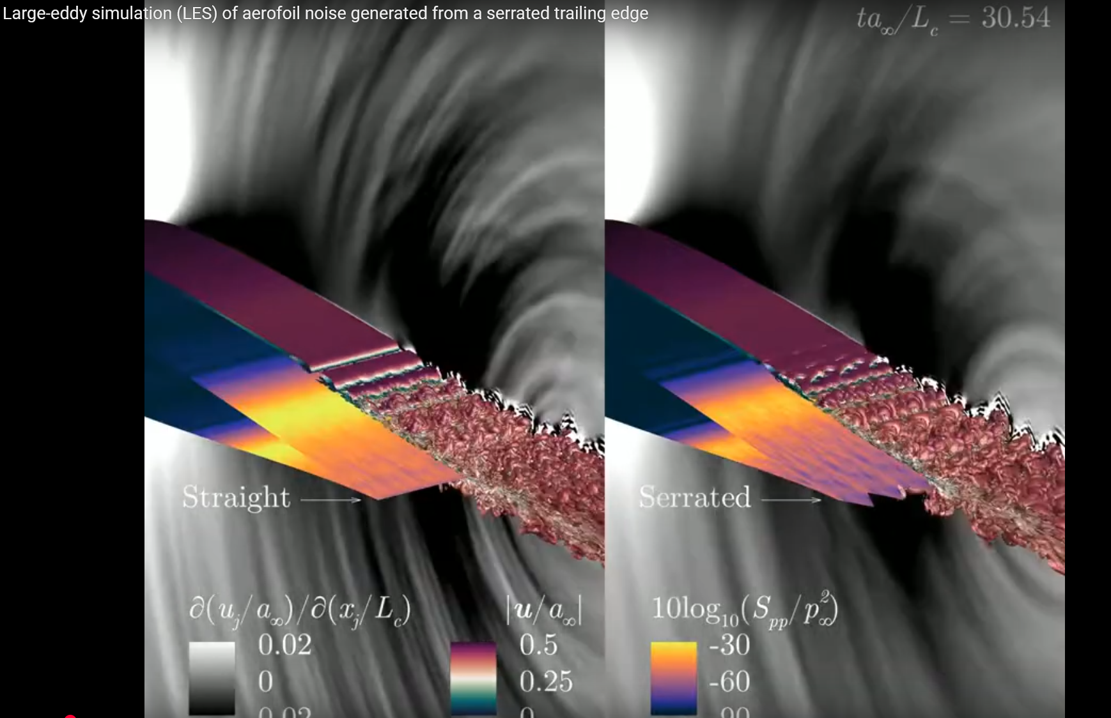
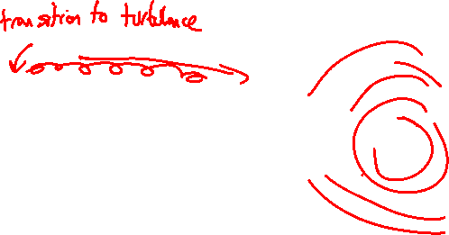
Trailing edge treatments
Trailing edge serrations reduce the turbulence correlation length
https://www.youtube.com/watch?v=YAl9PR6U63k

Slide 9
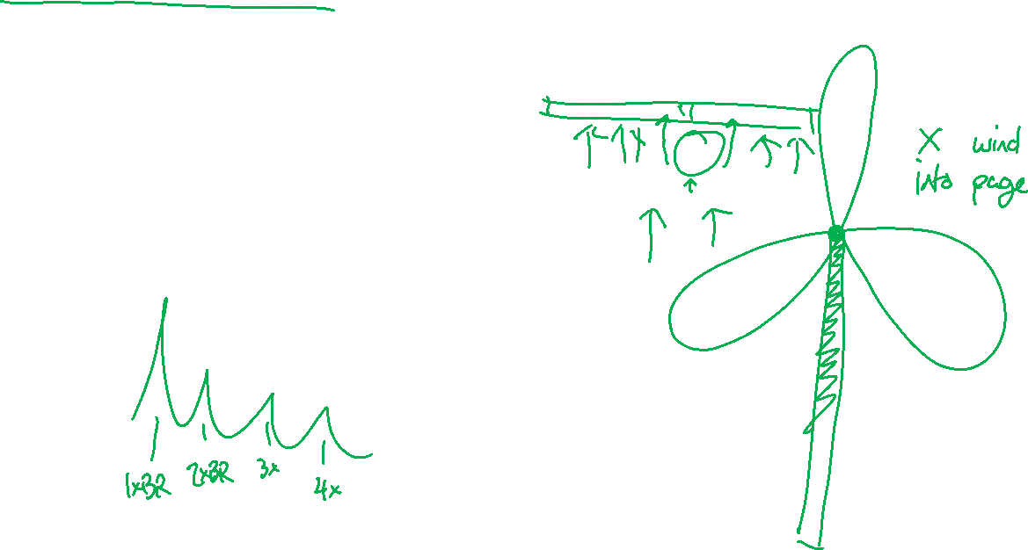
Ingested blade-rate noise
An obstruction upstream causes a change in flow
The change in flow causes unsteady forces on the rotor each time a blade passes.
Similar to an impulsive source, harmonics are usually also seen.

Slide 10
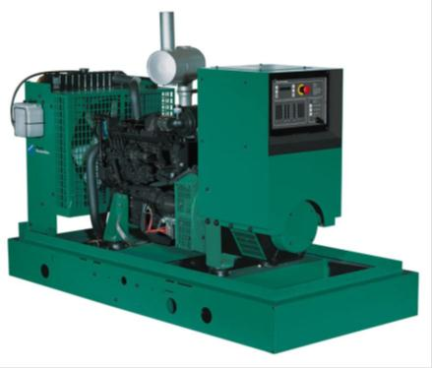
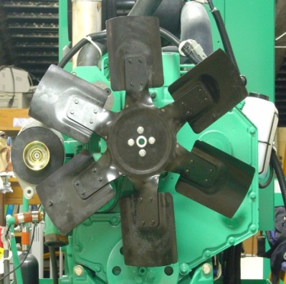
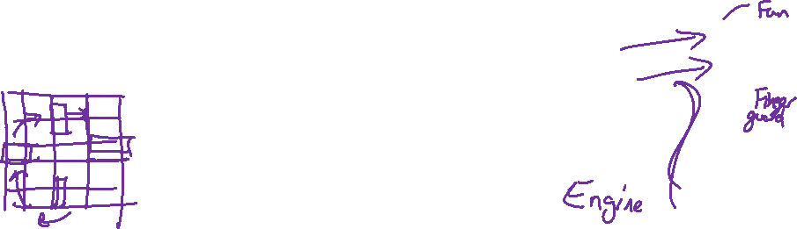
Ingested blade-rate noise
Straight wakes meeting straight blades can make blade rate noise very loud.
Spider (Hub)
Shroud
Rotation
Finger guard
Radiator
Engine
Kim, Geon-Seok, “Discrete-Frequency and Broadband Noise Radiation from Diesel Engine Cooling Fans,” Ph.D. Thesis in Acoustics, The Pennsylvania State University, December 2007.
Leading edge
Trailing edge
Blade tip

Slide 11
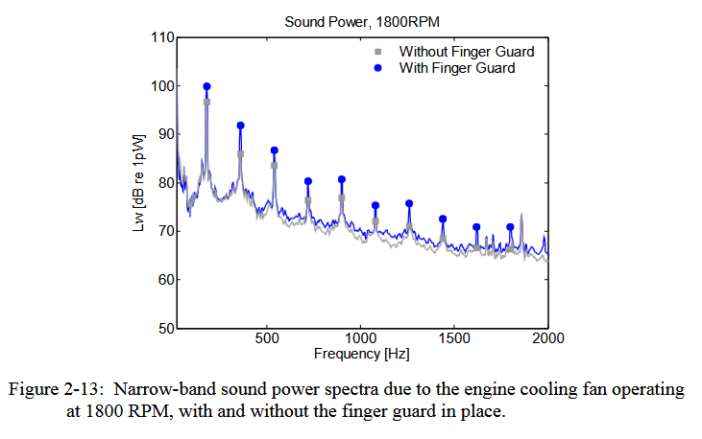
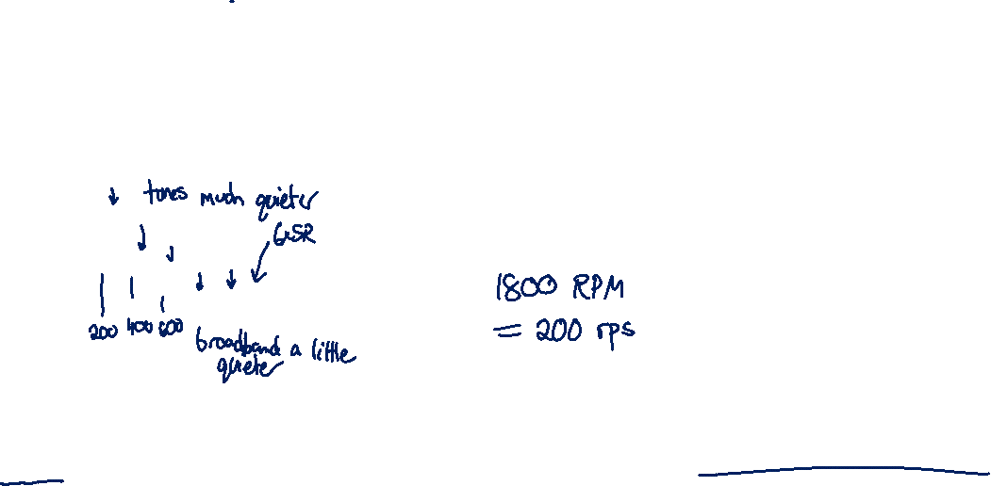
Ingested blade-rate noise
Removing the upstream obstruction to make the incoming flow more uniform.
Kim, Geon-Seok, “Discrete-Frequency and Broadband Noise Radiation from Diesel Engine Cooling Fans,” Ph.D. Thesis in Acoustics, The Pennsylvania State University, December 2007.

Slide 12

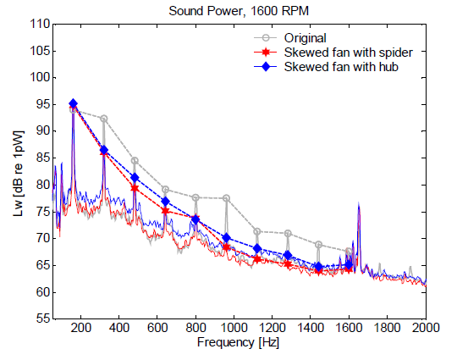
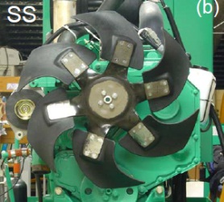
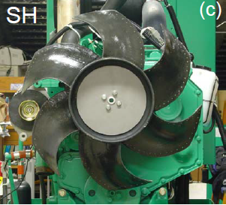
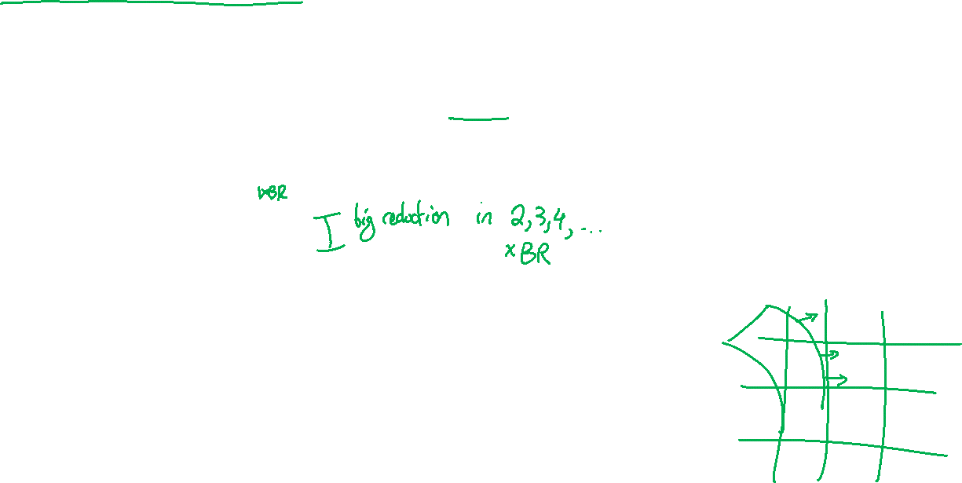
Ingested blade-rate noise
Adjust the shape of the blades (skew) to spread out the interactions in time.
1xBR Dominated by Tip/Shroud Opening Interaction
Kim, Geon-Seok, “Discrete-Frequency and Broadband Noise Radiation from Diesel Engine Cooling Fans,” Ph.D. Thesis in Acoustics, The Pennsylvania State University, December 2007.

Slide 13
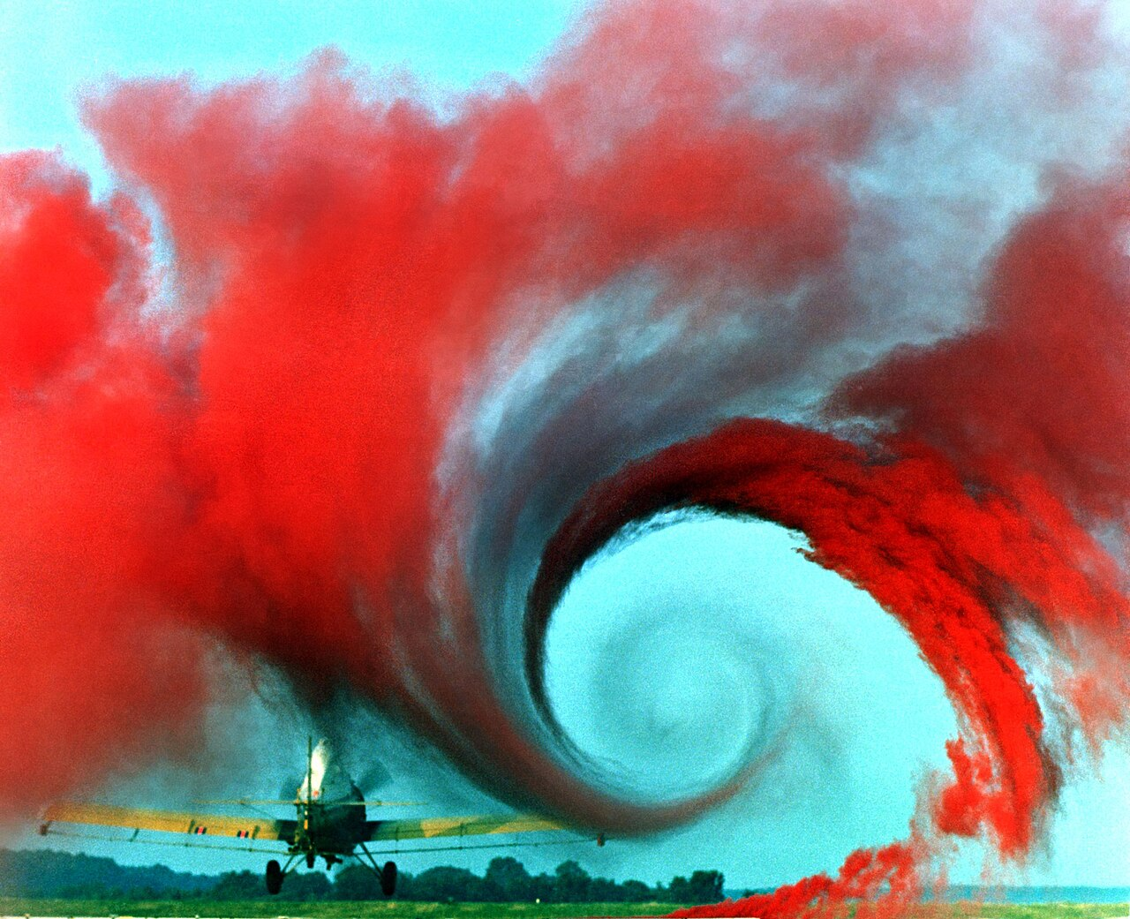
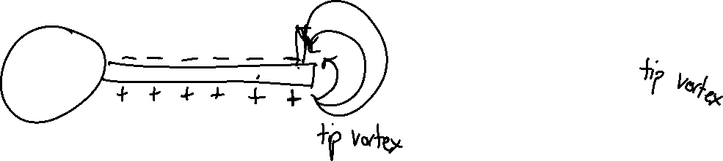
Self-generated blade-rate noise
Wings and blades generate large-scale, relatively stable vortex structures.
If one blade leaves a vortex behind, the following blade can impact it, leading to blade rate tones.

Slide 14
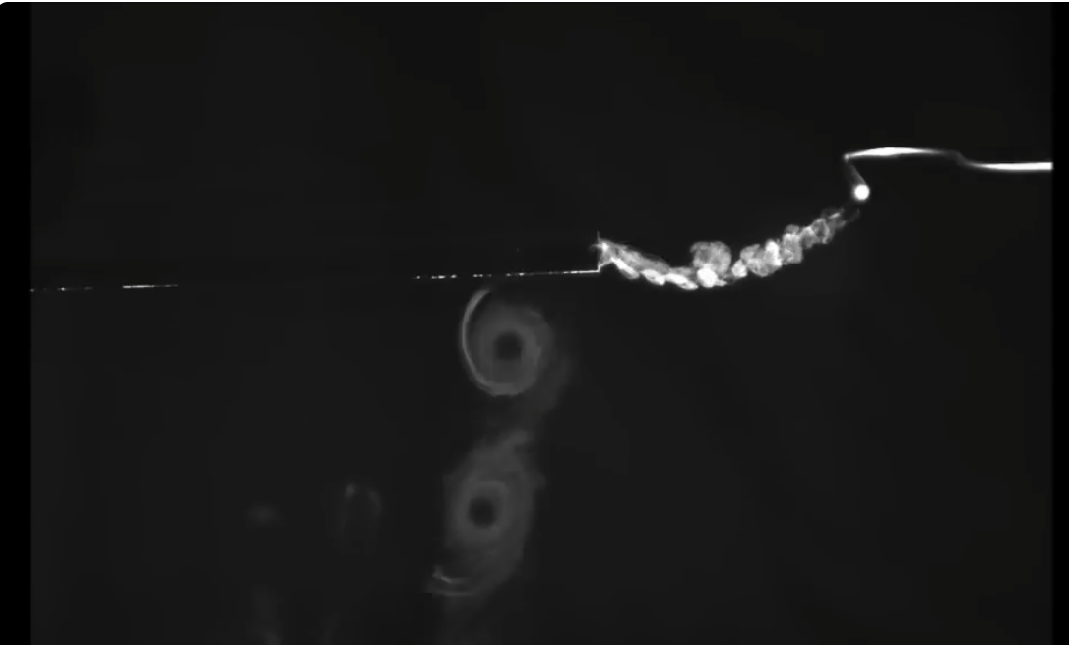
Self-generated blade-rate noise
Tip vortex
https://www.youtube.com/watch?v=AolOz2AkpiE

Slide 15
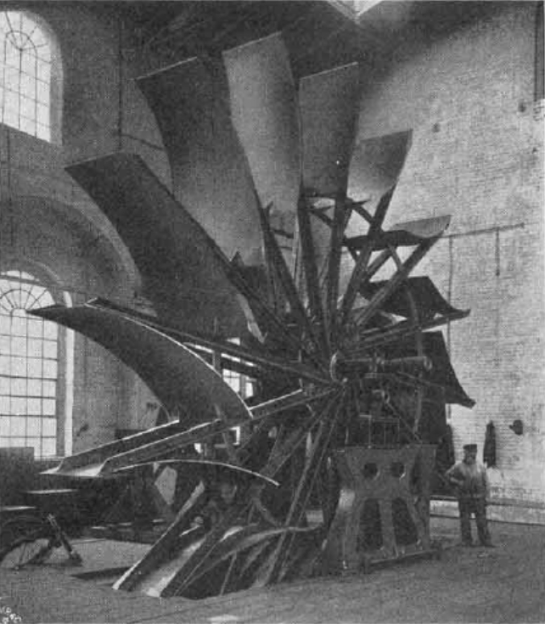
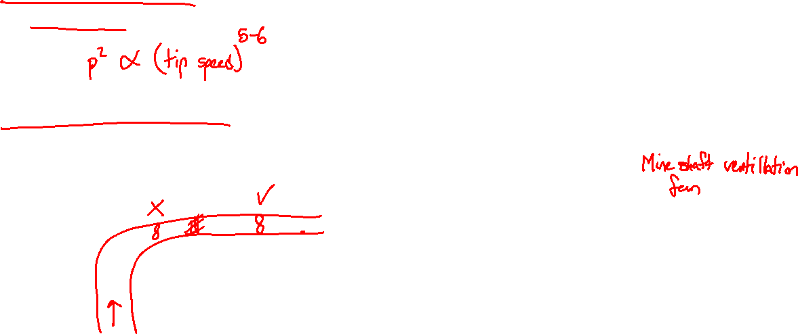
Reducing propeller noise
Reducing tip speed makes all mechanisms quieter
Larger fans are usually quieter for the same volumetric flow rate
Clean, wake-free inflow reduces turbulence ingestion and ingested wake noise
Avoid installing duct fans near bends and grilles

Slide 16
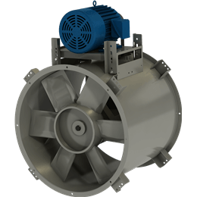
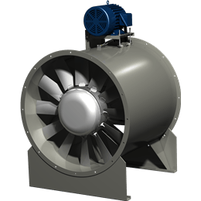
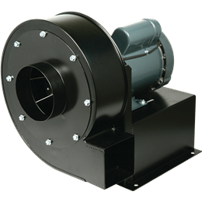

Commercial fans and blowers
Tube axial fan: flow is along the axis of rotation, just a propeller in a tube. Dominated by low frequency noise.
Vane axial fan: Tube axial, but with downstream guide vanes for higher efficiency. Fan can run slower, but downstream wakes increase mid-high frequency noise.
Centrifugal fan: Flow turns 90° through the fan. Generally quieter than axial fans.
https://www.greenheck.com/products/air-movement/fans/

Slide 17
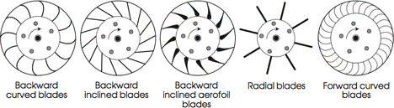
Commercial fans and blowers
Shape of blades in centrifugal fans can affect noise generation.
High volume flow rate, high pressure, loud
Maximum efficiency, minimum noise
Generate high flow rates, quiet
High-pressure applications
By EagleX - Own work, CC BY 3.0, https://commons.wikimedia.org/w/index.php?curid=12753938
https://blog.softinway.com/understanding-the-characteristics-of-varying-centrifugal-blower-designs/

Slide 18
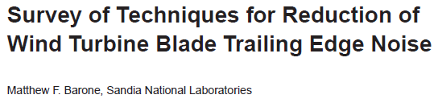
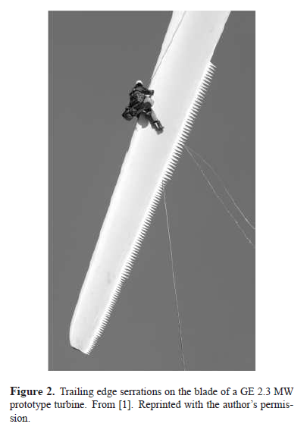
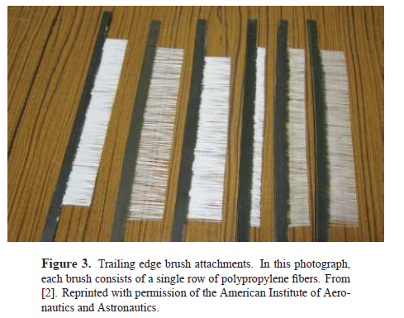
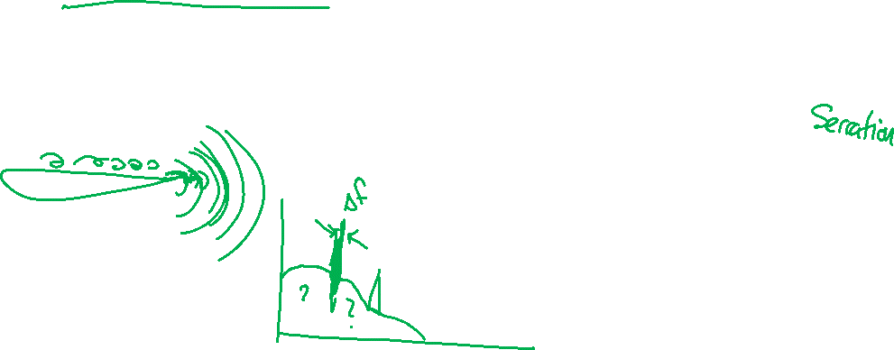
Wind turbine noise
Trailing-edge noise is the dominant generation mechanism.
Trailing-edge noise can be reduced by
Serrations: reduce coherent length
Airfoil shaping: reduce turbulence formation
Brushes and porous surfaces: reduce abrupt transition at trailing edge (impedance matching)

Slide 19

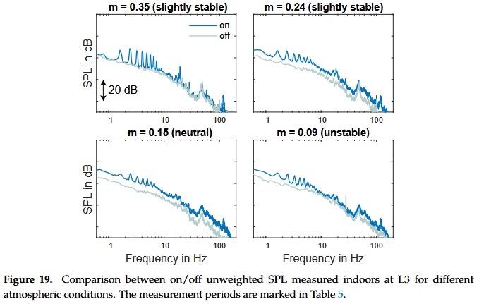
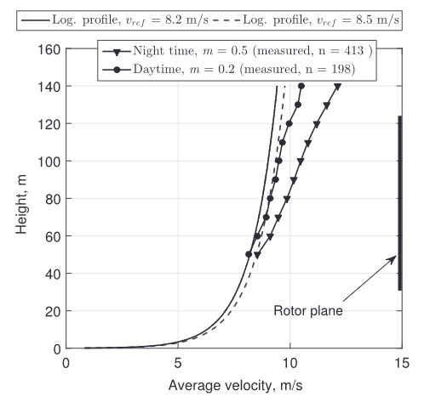


Wind turbine noise
Measuring wind turbine noise can be challenging.
Both the source and propagation to the ground depends strongly on atmospheric conditions.
Blade rate tones
$$m=\frac{\ln\left(\frac{v_{h}}{v_{ref}}\right)}{\ln\left(\frac{h}{h_{ref}}\right)}$$
Indoor room mode
Zajamšek, B.; Hansen, K.L.; Doolan, C.J.; Hansen, C.H. Characterisation of wind farm infrasound and low frequency noise. J. Sound Vib. 2016, 370, 176–190

Slide 20

Toroidal Mobius propellers revisited
The authors claim a significant noise reduction.
How is this reduction achieved?

Slide 21
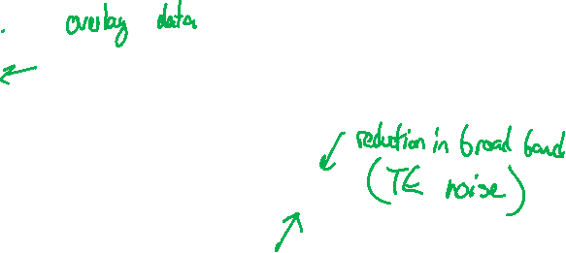
Toroidal Mobius propellers revisited
Blade rate noise: significantly reduced compared to baseline
Low-frequency noise: increased (more TI noise)
High-frequency broadband: reduced (reduced TE coherent length?)

Slide 22
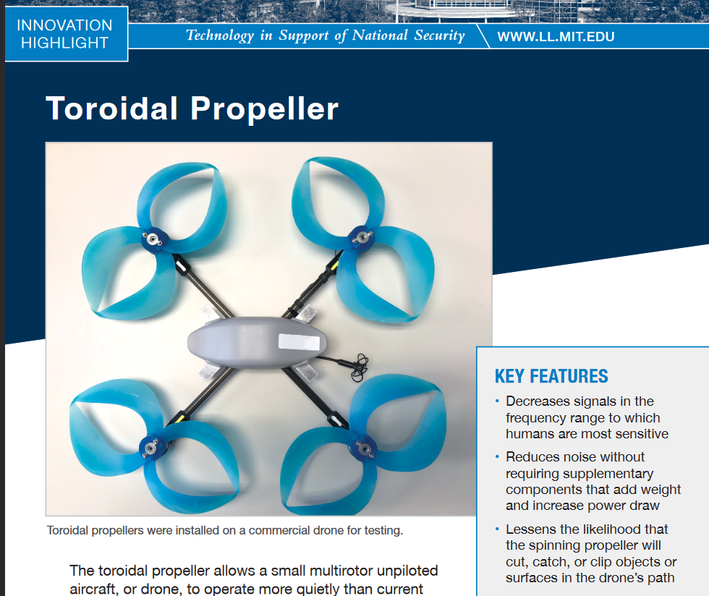
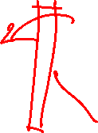
Toroidal Mobius propellers revisited
Baseline straight blades would cause wake noise from interaction with straight struts.
It would be more fair to compare curved blades without loops to curved blades with loops.

Slide 23

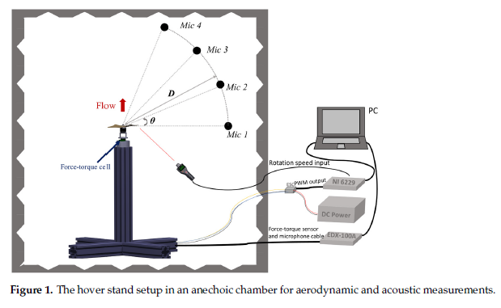


Toroidal Mobius Loop propellers revisited
Better experimental design: single propeller with minimal wake interference.
Include background and motor noise measurements

Slide 24


Toroidal Mobius Loop propellers revisited

Slide 25


Toroidal Mobius Loop propellers revisited

